Slide 1


Engaging in Advocacy to Build an Alternative Pathway to Justice
Budget Proposal: Restorative Justice for Survivors of Trafficking

Slide 2
Who Who We Are
Anabel Martinez
Senior Policy Counsel Local
Aradhana Tiwari
Senior Policy Counsel State

Slide 3
Who We Are
Sunita Jain Anti-Trafficking Initiative
Notes:
(AT)- SJI = 100% anti-carceral
(AT)- Prevention & Support survivors
(AT)- State Work & State Agenda
(AM- Evidence based & Survivor informed
(AM)- LA County work
Introduce SJI local work
Procurement policies
LTFC work
Study

Slide 4
Objectives
Overview of the Restorative Justice for Survivors of Trafficking Budget Proposal
Work in Progress
How this proposal was developed
Learning about the Budget Process
CA State Process
LA City / County Process
Understanding the timeline for advocacy & when to engage
Notes:
Overview of the restorative justice for survivors of trafficking budget proposal
Learning about budget process
Understanding the timeline for advocacy & when to engage
We will discuss how that looks like for the both state and local advocacy later in proposal

Slide 5
Long-Term Strategy for Prioritizing Restorative Justice Budget Proposal
SJI has comprehensive Budget Request Developed for HT & Prevention
  30.2 Million in one-time funding
  9.7 Million in continuing funding
  -Full SJI California Budget Proposal available here
  Why RJ First?
  Law enforcement is currently allocated a disproportionate amount of all state resources
  Funding will never shift away from LE until we offer an alternative
  Long-term strategy to shift resources with evidence based data
Notes:
Why RJ over other funding priorities?
We recognize that there are many services and resources that survivors of HT need that should be funded, advocates and survivors can prioritize something else but want to take a moment to explain why we are prioritizing RJ proposal
SJI has developed a comprehensive budget proposal which requests money for other one-time expenses like a prevalence study or educational curriculum, as well as on-going budget requests for expanding outreach and training to support HT
We are prioritizing this proposal at this time because LE takes up a disproportionate amount of resources – nearly 50% of every municipal budget is allocated to police systems. We determined that unless we provide an alternative process to hold a trafficker accountable that existed beyond the prison system, we would not be able to divert the disproportionate amount of resources that are presently allocated to these systems
Unless there is an alternative, we will continue to put people in jail and be unable to move resources away from the prison industrial complex
In creating an alternative pathway to justice, one that is more cost-effective, we hope resources will then be freed up to be reallocated to other necessary services and resources that those who are vulnerable to commercial exploitation need
Because of our limited capacity we cannot engage in advocacy for these other services and resources while also pushing forward this new idea
SJI has a full funding proposal that focuses on other resources and services as well (close to 40 million)
Prevalence Study Gain a better understanding of the extent, prevalence, location and demographics of impacted communities $3,000,000
Educational Curriculum Develop educational curriculum to prevent human trafficking and foster safer relationships in CA Schools $2,500,000
Restorative Justice Pilot Project Develop and Administer the nation’s first restorative justice program as an alternative to traditional carceral punishment $25,000,000 TOTAL
ONE-TIME $30,250,000 PROGRAM DESCRIPTION COST
Training & Technical Resources Providing Training and Technical Resources to Service Providers and other first responders; $3,750,000/yr
Outreach and Enforcement through Civil Rights Division (CDR) Increasing outreach and enforcement through CRD $3,000,000/yr Outreach and Enforcement through Department of Industrial Relations (DIR) Empowering DIR to prevent trafficking state wide $3,000,000/yr
TOTAL REQUESTED IN CONTINUED FUNDING $9,750,000

Slide 6
Restorative Justice Proposal Sections
How Restorative Justice can support survivors of trafficking
Why Restorative Justice should be used for survivors of violent crime
Cost & Savings
Notes:
How Restorative Justice can support survivors of trafficking—MAKE MORE SIMPLE FOR EXAMPLE. Data shows that survivors have asked for this since 2018 but no program in the US to date! In a study 75% of labor and sex trafficking survivors did not want to see trafficker in jail. (I would delete all this. And say first section address RJ specially for HT and why as it’s a new idea
Restorative justice aligns with survivors' desires, focusing on preventing further harm.
Evidence shows restorative models aid in healing and reduce recidivism.
LA should pioneer a community-based restorative justice program for trafficking survivors.
Over 75% of survivors in a DOJ study didn't want their traffickers incarcerated.
Restorative justice provides survivors with autonomy and a meaningful role in the justice process.
A new approach could set a precedent, providing a model for other regions to follow.
Why Restorative Justice should be used for survivors of violent crime
Make more simple: I would say: most RJ programs are for juveniles or misdemeanor offenses but SJ and research shows that victims of violent crime suffer the most in the criminal process so why are they not offered these alternatives? This sections justifies why victims of crime should be given this option!
Long prosecution times and threat of charges against victims increase distrust in the system.
Incarceration doesn't reduce trafficking or rehabilitate offenders, potentially worsening the problem.
Survivors fear incarceration improves traffickers' tactics and networks.
Current justice model fails to address root causes and fails to prevent reoffending.
Survivors want accountability focused on preventing further harm, not incarceration.
National discussions on reducing prison populations align with the need for new approaches.
Cost & Savings
For legislators cost matters this is why we try to show in this section the county of LA will save money in the long run if they invest in RJ. And that is can provide wrap around sevices for survivord AND responsbile partoes to stop harm for less cost than just putting someone in jail and survivors getting no servives.
This is why we included this information because we questions and push back in these areas
You will look at this full proposal and we will provide space tomorrow to talk about it

Slide 7
Costs
$25 million dollars for 5-year pilot human trafficking restorative justice program
  5 years = 1 year start up + 2 year RJ process X 2 cycles
  $5 million/year would be provided:
    (1) Provide wrap-around services to survivor-victims for 2 years and
    (2) A 2-year restorative justice process for accountable parties facilitated by a community based organization with experience in RJ
  Survivors AND accountable parties would both need to voluntarily opt-in to this process
  If the survivor changes their mind, or the accountable party does not follow the rehabilitation plan the case is transferred back to traditional criminal prosecution model
Notes:
In those programs that provide pre-conviction diversion, DAs will refer a case for an RJ process by first asking the victim-survivor if this is something they want. They then see if the accountable party wants to opt in. Only then is the case referred to an RJ process

Slide 8
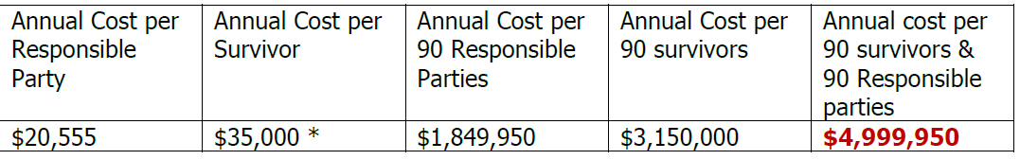
Cost & Cost Savings
Notes:
By Surveying other restorative justice programs we found for that for about half the cost of incarcerating an individual for 1 year in California (106k), restorative justice programs offer wrap-around support to survivors AND a facilitated process for the accountable party to better ensure the prevention of future harm. Currently, 87% of survivors reported not receiving any financial or economic assistance to help recover
Discuss how these costs were derived
20,555: Based on our findings from other restorative justice programs, this number is well within the average range of costs for providing rehabilitative services.For example, Advance Peace, a Sacramento-based nonprofit organization, organizes a program for individuals who are involved in gun violence to receive mentorship and life coaching. This is an 18-month program for 50 fellows who are individuals who have been arrested for crimes. The total cost of the program was $1,384,836, or approximately $18,464 per year per fellow
$35,000: This number includes the costs for wrap-around services for survivors, including case management, shelter, legal services and other direct cash assistance support. Access to these types of services is now extremely limited given the resource focus on incarceration
90 Responsible Parties & 90 Survivors: This number was extrapolated from data provided from the LA County District Attorney’s Office detailing the number of human trafficking filings and arrests in LA County between 2020-2022. This information is available in Appendix B of the proposals you have in front of you.
Based on our review of the data, there was an average of 89 filed cases against accountable parties annually. Our annual budget therefore is based on the cost of facilitating a restorative justice process for 90 accountable parties, and 90 impacted survivors.
Total number of people served in 5 years: Assuming 1 year of start-up costs, this proposed budget would provide services to roughly 360 individuals over a 5 year grant
Cost Savings: we believe implementing a restorative justice program would approximately yield at least a 5-to-1 cost benefit ratio.33 This means for every dollar spent on a restorative justice program for survivors and those who have harmed them, the criminal justice system would save $5.
Under this proposal, California would save approximately $23 million dollars if they implemented such a program over five years.
From a cost-savings perspective alone, it would be beneficial for California to take the important step of adopting a pilot restorative justice program for human trafficking survivors as an alternative to traditional criminal justice prosecution.

Slide 9
Important Required Structures in RJ Funding Plan
Funding if provided, will be distributed through a competitive grant process
  CALOES is an agency that will oversee the program
Funding will specify that it can only go to community groups (NOT LEA)
Funding will specify that it is for a PRE-FILING RJ process only
  Important as many RJ programs are post-conviction, save no resources, and do not avoid the harm of the carceral system
Notes:
RJ funding is structured so it does not go to LE
We have specifically worded the proposal so that this money goes to community based organizations
Grass root organizations will be apply for this
CalOES oversees the HT specified money that is allocated to roughly 20 orgs throughout California - that’s why we chose this org in our proposal
Cal Office of Emergency Services
Emphasize diversion PRE Conviction
In proposal – we are pulling standards from things that are already being used Federally VAWA – which excluded HT

Slide 10
Examples of Restorative Justice Programs
Highlighted as Models in Budget
Example 1: Common Justice (New York)
Diversion Program for violent felonies (robbery & assault) if and when the victim-survivor agrees
Focus on accountable parties ages 16-26
90% of victims chose the program over traditional justice.
Only 6% recidivism rate among participants.
Common Justice involves victims, responsible parties, and community members.
Example 2: RESTORE (Pima County, Arizona)
Addresses felony sexual assault cases.
PTSD among victims dropped from 82% to 66% after participation.
90%+ of participants felt safe and supported; 83% believed justice was done.
RESTORE focuses on victim support and offender accountability, showing positive mental health outcomes
Example 3: Re-Store Justice (Richmond, California)
Five-year program for both victims and offenders, started in 2019.
Offenders receive substance abuse treatment, counseling, education, and job training instead of criminal charges.
Community groups, law enforcement, and defense attorneys collaborate to create tailored plans.
Notes:
In the proposal we give examples of other programs that have worked and had good results which can serve as a model for hunman trafficking programs. One of the biggest questions we get is what the model will look like as we don’t have any examples so these are the best models and data we could find to explain how it might work for HT.
Example 1: Common Justice (New York)
Diversion Program for violent felonies (robbery & assault) if and when the victim-survivor agrees
Focus on accountable parties ages 16-26
90% of victims chose the program over traditional justice.
Only 6% recidivism rate among participants.
Common Justice involves victims, responsible parties, and community members.
Example 2: RESTORE (Pima County, Arizona)
Addresses felony sexual assault cases.
PTSD among victims dropped from 82% to 66% after participation.
90%+ of participants felt safe and supported; 83% believed justice was done.
RESTORE focuses on victim support and offender accountability, showing positive mental health outcomes
Example 3: Re-Store Justice (Richmond, California)
Five-year program for both victims and offenders, started in 2019.
Offenders receive substance abuse treatment, counseling, education, and job training instead of criminal charges.
Community groups, law enforcement, and defense attorneys collaborate to create tailored plans.
Programs demonstrate the effectiveness of restorative justice in reducing recidivism and promoting healing.
Programs provide a model of costs
Emphasize community involvement and victim-centered approaches.

Slide 11
Advocating for State Budget Asks

Slide 12
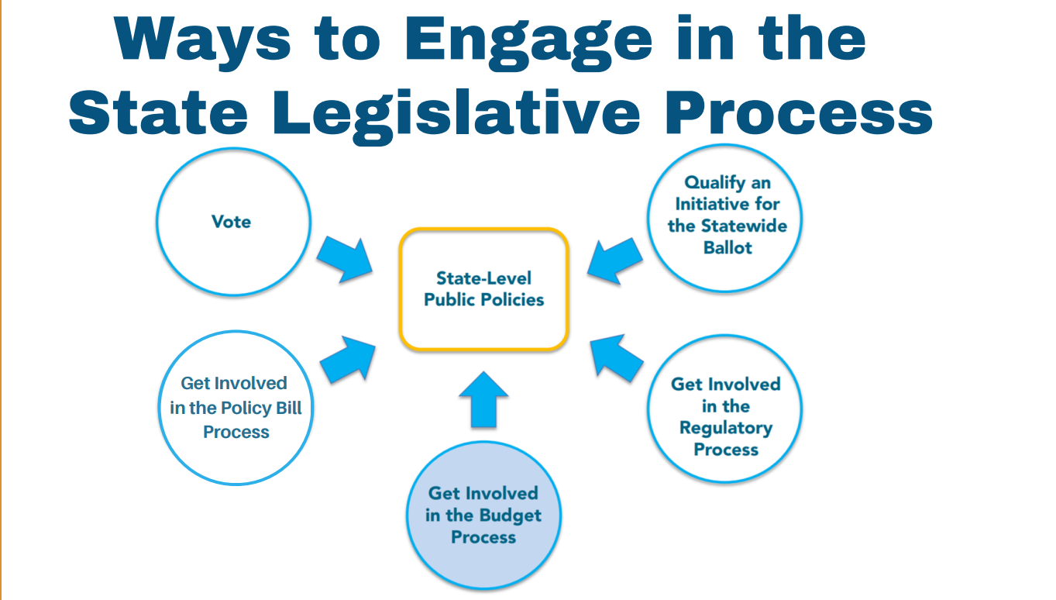
Notes:
Each way to engage is different. Buget is one of the hardest and most difficult processes to work on—everyone wants money for something!

Slide 13
Budget Request - A Different Type of Bill
In comparison to other types of legislation, "budget bills":
  Provides authority to spend money for a single year and
  Budget Trailer = provides structure to implement bill
Separate Budget Committees on its own timeline
Notes:
Budget requests are complicated and difficult for grass root organizations to be a part of even though we depend on these processes for keeping essential programs and services alive.
These processes are complicated because they change slightly every year -
Provide authority to spend money across an array of public services and systems for a single year
Move through the legislature's budget committees on its own timeline
Move with other bills that are needed to implement the policies assumed in the budget – These are known as trailer bills

Slide 14
Why is Budget Advocacy Important
Budget provides a framework and funding critical for public services and systems – from childcare and education to health care to housing and transportation
Budget is more than money – its about how we express our values and priorities
Budgets impact ALL people living in that region – participating in the budget process ensures that elected officials are making choices need for every person – from different races, backgrounds and places – to thrive
Budgets requests are policies which seek to provide authority for how money is spent
Notes:
Budget provides a framework and funding critical for public services and systems – from childcare and education to health care to housing and transportation
Budget is more than money – it's about how we express our values and priorities
Budgets impact ALL people living in that region – participating in the budget process ensures that elected officials are making choices need for every person – from different races, backgrounds and places – to thrive
Budgets requests are policies which seek to provide authority for how money is spent

Slide 15

Budget Advocacy Challenges 2024 and Beyond
Budget advocacy for new resources is often a 2-7 year Process
Budget Deficit
Budget Cuts
Process is not consistent and changes year to year
Notes:
Budget advocacy is a 2-7 year process
First year is spent educating champions and allies on why budget request is important
For context: it took roughly 7 years to secure the 10 million in continued funding for HT specialized services in CA
Budget Deficit
Currently both the State and County are in a budget deficit , making it harder to advocate for NEW programs/ initiatives
Budget Cuts
There is also deep federal and state budget cuts to social services, putting the burden on the state and county to make up the deficit caused by the budget cuts
VOCA funding was cut by 30%

Slide 16
Continuing vs. 1 Time Budget Request
Continuing Budget Request
  This means after the money is included in a budget bill it is always included in the budget in the years after
Examples
  10 Million for specialized services for HT
  21 Million for specialized services for CSEC in DCFS
1 Time Budget Request
  Often you start with a onetime request
    This data then gives you the information/political will to make it continuing
  Can take many more years of advocacy
  Example(s)
  10 Million HT funds initially was 1 time request for 3 years and then became continuing
  RJ Proposal: Provides funding for 5 years but is one time request
Notes:
Explain difference between continung budget—it is in that years budget only but can be money for 5 years-like our program, Or when it gets in the budget it si thereforver so example after we got the continuing 4 years ago we did not have to advocate anymore but have gotten 10 million a year so 40 million with no additional work!
Don’t understand these notes hereWhy RJ over other funding priorities?
We recognize that there are many services and resources that survivors of HT need that should be funded
SJI has developed a comprehensive budget proposal which requests money for other one-time expenses like a prevalence study or educational curriculum, as well as on-going budget requests for expanding outreach and training to support HT
We are prioritizing this proposal at this time because LE takes up a disproportionate amount of resources – nearly 50% of every municipal budget is allocated to police systems. We determined that unless we provide an alternative process to hold a trafficker accountable that existed beyond the prison system, we would not be able to divert the disproportionate amount of resources that are presently allocated to these systems
In creating an alternative pathway to justice, one that is more cost-effective, we hope resources will then be freed up to be reallocated to other necessary services and resources that those who are vulnerable to commercial exploitation need

Slide 17
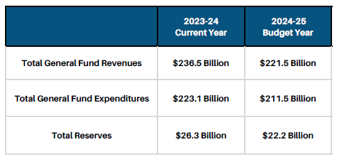
Is 25 million over 5 years a lot of money?
Notes:
The Governor’s budget for 2023-2024 has allocated $14.5 billion to operate the California Department of Corrections and Rehabilitation (CDCR). An additional $5.3 billion is allocated for the judicial branch for criminal proceedings. This money - nearly $19 billion- is allocated from the General Fund
Today, it costs approximately $106,131 to incarcerate one individual in California, a number that has increased by 117% since 2011

Slide 18
Key Dates & Key Procedure in the
CA State Budget Process
January 10th – Governor proposes budget for upcoming fiscal year. Budget must be balanced – estimated revenues must meet or exceed the proposed spending
May 14th – Governor releases revision
June 15th – Legislature must pass balanced budget bill - General Fund revenues must match General Fund spending
July 1st – Start of Fiscal year
Notes:
Internal process in which Governor establishes balanced budget → Legislature can approve, modify or reject these proposals + can add new spending changes that substantially revise governor’s proposal
Simple majority vote of each house needed to pass budget bills
Advocates find champion in Senate and/or Assembly
Meet with budget subcommittee to gain support
Get general broad support
2/3 vote needed to pass bills that increase taxes or propose constitutional amendments
Gov. modifies at May revision
Signs or vetoes bills included in budget package
2/3 vote needed in each house to override governor’s veto of bill or appropriations

Slide 19
How do we advocate for the budget?
Education & Outreach – On-Going & Consistent
  Legislature: Meetings with elected officials to educate
  Governor: Meeting with Governor's Office + Dept. Of Finance
  Public: Media engagement to shift narrative
Network Building & Organizing - On-going & Consistent
        Build a coalition & organizational to support
        Meetings with elected officials and agencies to influence budget
Secure ‘Champion’ for Budget Request – October – January
        Champion = Only elected officials can submit budget requests. A champion is an elected official (Assembly Member or Senator) who will submit the request
Develop Your Written Materials + Talking Points - October – January
Notes:
Meetings, networking, raising awareness
Meetings, networking to gain support from community partners
Secure 'Champion' - Champion = Only elected officials can submit budget requests. A champion is an elected official (Assembly Member or Senator) who will submit the request

Slide 20
Timeline for Advocacy Activities
Summer - Fall
    Education & Outreach: Advocates submit letters and meet with Gov Staff and Dept of Finance
    Network Building & Organizing: Coalition building + establishing allies with agencies, organizations and government officials
October – Mid February
        Secure: 'Champion' for Budget Proposal
        Develop / update proposal & talking points: based on feedback from organizational partners, coalitions and impacted community members as well as lessons learned from previous year. Develop talking points based on updates in proposal + political environment
January - Mid-May
    Education & Outreach: Advocates meet with Budget Subcommitee Staff
    Network Building & Organizing: Advocates seek broad support for request from as many members as possible
Late Feb – Early May
    Education & Outreach: Advocates continue efforts to get request prioritized through meetings, media engagement / press conferences, showing broad support with coalitions uplifting efforts (sign-on letters, social media engagement)
Notes:
Every year the budget process changes slightly - This makes it hard for
SJI will keep track of this and work with advocates on these changes - This
Fiscal year Begins July 1st and Ends June 30th
SUMMER TO FALL : State departments & agencies – prepare baseline budgets needed to maintain existing service levels and may prepare ‘budget change proposals’ intended to alter service levels
Independent of Governor but Governor will use these proposal when preparing his proposed budget for release in January
Mid May / May 14th: Advocates engage in advocacy with the Gov to get in Budget revise
Mid May – Early June: Advocates Continue Work with Senate and Assembly

Slide 21
Advocating for LA County Budget Asks
Notes:
Moving on to LA
Some things are the same as the state some things are different

Slide 22
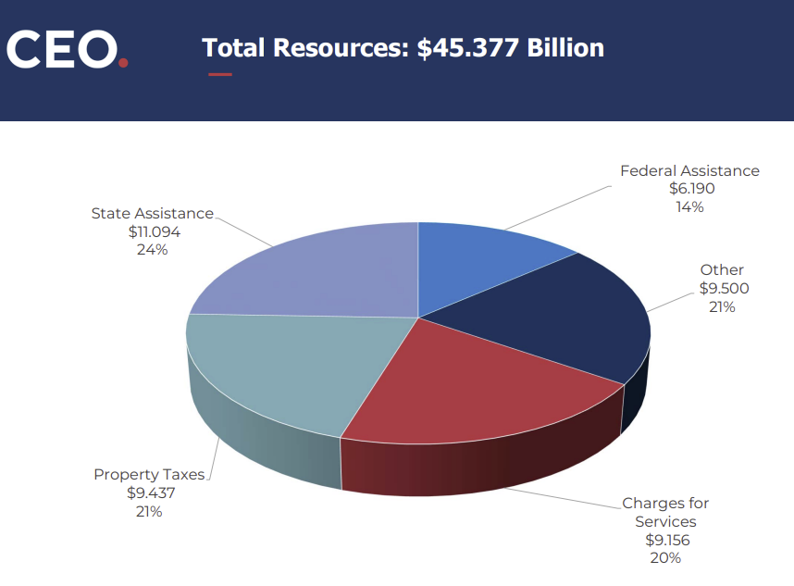
What Resources Make Up the $45.377 Billion LA County Budget?
14% Federal Assistance
24% State Assistance
21% Property Taxes
21% Other
20% Charges for Services
Notes:
La budget for next fiscal year from July 2024 to June 2026
For upcoming year, la county has a budget of 45.377 billion dolalrs
14% Federal Assistance
24% State Assistance
21% Property Taxes
21% Other
20% Charges for Services

Slide 23
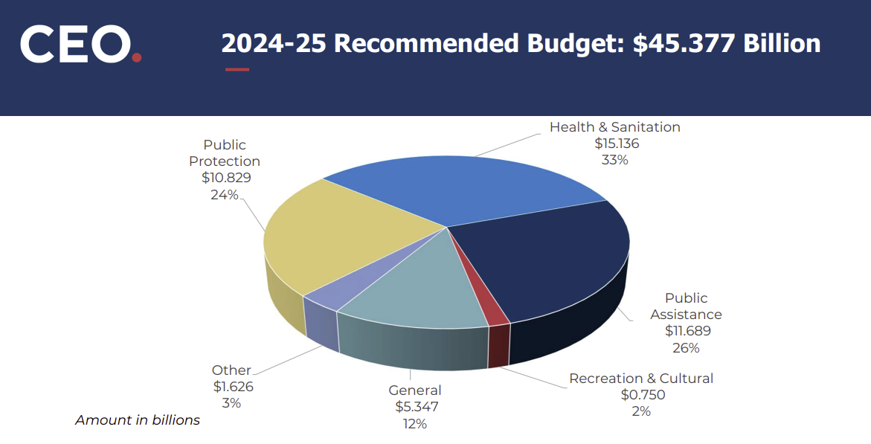
How is LA County's $45.377 Billion Budget Being Allocated?
33% Health and Sanitation
26% Public Assistance
24% Public Protection
12% General
3% Other
2% Recreation & Cultural
Notes:
how money is spent
33% Health and Sanitation
26% Public Assistance
24% Public Protection
Fire department
Sherriff
12% General
3% Other
2% Recreation & Cultural
Questions:
Does anything surprise from how the money is spent?

Slide 24
Key Dates & Key Procedure in the
LA County Budget Process
January
County manager prepares budget for instructions
Feb.–Apr.
County departments develop budget request
County manager reviews budget requests
April
Chief Executive Officer presents a recommended budget to the Board of Supervisors (“BOS”)
Public hearings are scheduled
May
BOS makes a recommended budget available for public review and announces a public hearing date
Budget hearings take place and advocates can provide testimony specific to recommended budget
June
BOS convenes public hearing to review recommended budget
BOS may revise the recommended budget
BOS approves the recommended budget with or without revisions by June 30th
County makes proposed budget available for public view
July–Sep.
County Manager prepares an updated budget
BOS convenes a public hearing to consider the updated county budget
October
BOS formally adopts the budget, possibly with additional revisions by Oct 2nd
Oct.–Dec.
BOS, County Manager, Department Heads, and the public look ahead to the next budget
Notes:
Fiscal year Begins July 1st and Ends June 30th
As you can see through out the year different there is always something happening budget related

Slide 25
How Advocates can Engage in the LA
County Budget Process
Identify and reach out to county agencies to ask them to add budget ask in their budget proposal
Potential County Agencies:
Justice Care and Opportunities Department
Public Defender/Alternative Public Defender
District Attorney
Youth Development Department
Individual meetings with 5 members of Board of Supervisor (BOS) with funding need
Current LA County BOS:
D1: Hilda Solis
D2: Holly J. Mitchell
D3: Lindsey P. Horvath
D4: Janice Hahn
D5: Kathryn Barger
Provide public comment during budget hearings
Can be in writing or in person
Get BOS to submit a Motion with Budget Ask
Notes:
These are the many ways in which you can advocate for the budget locally
Identify and reach out to county agencies to ask them to add budget ask in their budget proposal
Individual meetings with 5 members of BOS with funding need
Provide public comment during budget hearings
Get BOS to submit a motion with budget ask
You don’t have to engage in all these forms you can step in at any stage
In the next slide we will see at what points and during what time you can engage with SJI in the budget advocacy process

Slide 26
When do we advocate?
On-going and Consistent:
Outreach & Education
Legislature: Meetings with elected officials to educate and advocate*
Agencies : Meeting with LA County Agencies to educate and advocate*
Public: Media engagement to shift narrative*
Build a coalition to support*
October – December: Proposed Budget Preparation
Engage membership
Secure ‘Champion’ for Budget Request*
Research budget an identify demands *
January – March : Proposed Budget is Being Finalized
Develop Written Materials + Talking Points*
Finalized and refine demands based on feedback received*
Continue to meet with champions & decisions makers*
April - June: Proposed Budget is Released
Advocacy to influence budget before May Revision & Finalization in June
Continue to meet with champions*
Analyze recommended budget and finalize demands
Review recommended budget, engage community*
May- June: Budget Hearings & Passage
Turnout, mobilize, public comment, media*
Final push, turnout*
* Points at which Survivor Consultant can support SJI’s Advocacy
Notes:
Champion = Can either be a Agency Director or a BOS. An agency director can add budget request to their proposed agency budget and a BOS can submit budget request directly to budget
On-going and consistent:
Outreach & Education
Legislature: Meetings with elected officials to educate and advocate*
Agencies : Meeting with LA County Agencies to educate and advocate*
Public: Media engagement to shift narrative*
Build a coalition to support*
- October – December: Proposed Budget Preparation
Engage membership
Secure ‘Champion’ for Budget Request
Survivor consultant can join in meetings
Research budget an identify demands
Survivor consultant can provide feedback on budget proposal
January – March : Proposed Budget is Being Finalized
Develop Written Materials + Talking Points
Survivor consultant can help develop this
Finalized and refine demands based on feedback received
Survivor consultant can join meetings
Continue to meet with champions & decisions makers
Survivor consultant can join in meetings
April - June: Proposed Budget is Released
Advocacy to influence budget before May Revision & Finalization in June
Continue to meet with champions
Survivor consultant can join meetings
Analyze recommended budget and finalize demands
Survivor consultant can provide feedback
Review recommended budget, engage community
Survivor consultant can help engage community
May- June: Budget Hearings & Passage
Turnout, mobilize, public comment, media
Survivor consultant can help with mobilization, public comment, media
Final push, turnout

Slide 27
Q & A

Slide 28
Lets Practice!

Slide 29
Meeting with BOS Kathryn Barger
Create 3-4 Groups
Review briefing on BOS Kathryn Barger, sample agenda and split up talking points - 10-15 minutes
Simulate Meeting – 10 minutes
Notes:
Legislative Meeting with BOS Kathryn Barger – Making your sale's pitch
Break out into 3-4 Groups (10-15 minutes)
Within each group, participants will work on part A, B, or C. All participants will work on talking points for Part D – why is RJ important to them
SJI staff will split between the groups and provide support as the participants prepare for leg meeting
Speaker Talking Point: Please note that the talking points on page 3 are there to offer ideas but you should feel free to take creative license on how you would talk about the prompt with an elected official
Practice! (10 minutes)
SJI staff will rotate between groups and assume a new role of being Katheryn Barger's Legislative Director / Staff
How would you present the information to this office?
Added twist: SJI staff can push back / add opposition and give participants a chance to respond

Slide 30
How are you doing?
What did you learn?
What did you find easy?
What did you find challenging?

Slide 31
Do you believe we can build an alternative pathway to justice?
Sign up to be on Education Panel - we hope to host in the Fall
Join working group and listserv to plan for budget advocacy in LA county and State wide advocacy
Post on Social Media—SJI will send you a post on RJ once a month to post
Educate your organizations and coalitions - SJI can provide you with training materials
Train your task force and/or organization on Restorative Justice as an Alternative Pathway to Justice
Share Sign-On Letters of Support with Survivors and Organizations
Notes:
Pass around sign up sheet
Explain what each action item is

Slide 32
SLIDES TO DELETE
Slides following this slide are ones that were included in the original presentation (July 2024) but were redundant or superfluous
These slides are kept archived here in case they are relevant to future presentations

Slide 33
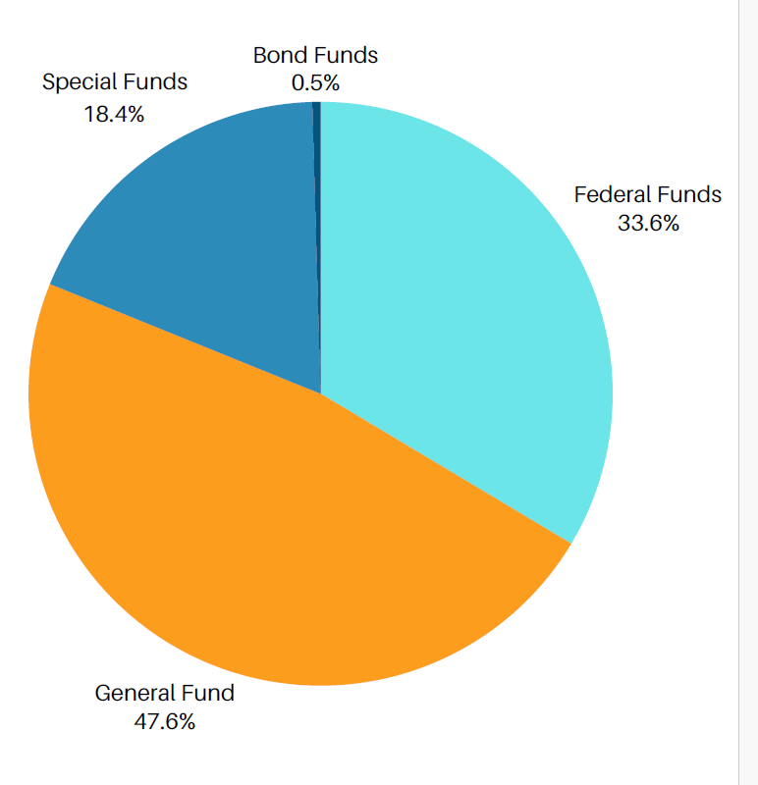
Overview of California 2024 – 25 State Budget
Federal Funds - Fed Govt provides significant resources in the areas of health & human services
General Fund - Accounts for revenues that are not designated for specific purposes. Supports education, health, human services, and state prisons
Special Funds - > 500 state special funds account for taxes, fees, and licenses that are designated for a specific purpose
Bond Funds – account for the receipt and disbursement of general obligation (GO) bond proceeds

